Slide 1




BANK LOAN OF CUSTOMERS
Project no : 160
PRESENTATION
Group no : 6

Slide 2

Group Members
Koppala Bhavana
Shravan Sekhar
Shaik Younuss
Shiv Kumar
Nitin
Jerrish

Slide 3



AGENDA
Project Introduction
Project Overview
Project KPI’S

Slide 4

Project Introduction
The Name of the project is “Bank Loan Of Customers” and it is under the domain ‘Finance’’.
It means Bank loans are financial products provided by banks to customers for various purposes. They allow individuals and businesses to borrow money and repay it over time with interest. Customers must meet certain criteria and provide documentation to qualify for a bank loan.
"Business analysts are a kind of switch from business problems to technological solutions."
The aim of the project is to analyze the growth that the bank achieved in given years according to the KPI’S.

Slide 5

Project Overview
KPI 1: Year wise loan amount Stats
KPI-2 : Grade and sub grade wise revol_bal
"Most Popular Business Analysis"
KPI-3 : Total Payment for Verified Status Vs Total Payment for Non Verified Status
KPI-4 : State wise and last_credit_pull_d wise loan status
KPI-5 : Home ownership Vs last payment date stats

Slide 6


KPI’S

Slide 7
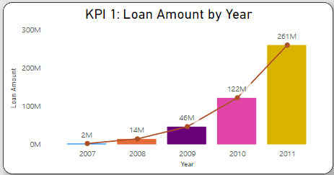

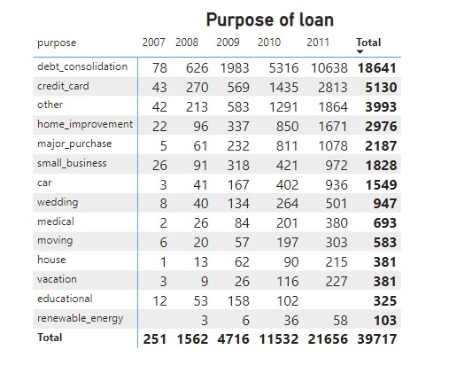
KPI 1 : Year Wise Loan Amount Stats
In KPI 1, we have to show the loan amount by year, in which we can observe that it is continuously rising.
In 2007, the loan amount was 2 million and in 2011, it went to 261 million.
The amount of the loan has increased by 259 million in 4 years.
The period from 2007 to 2008 witnessed the
most substantial surge in the interest rate for
loan amounts, with an increase of 548%.
Conversely, the smallest increase occurred
during the timeframe of 2010 to 2011,
which amounted to only 113%.
Profitability Objective
Promotional Objective
Growth Objective

Slide 8
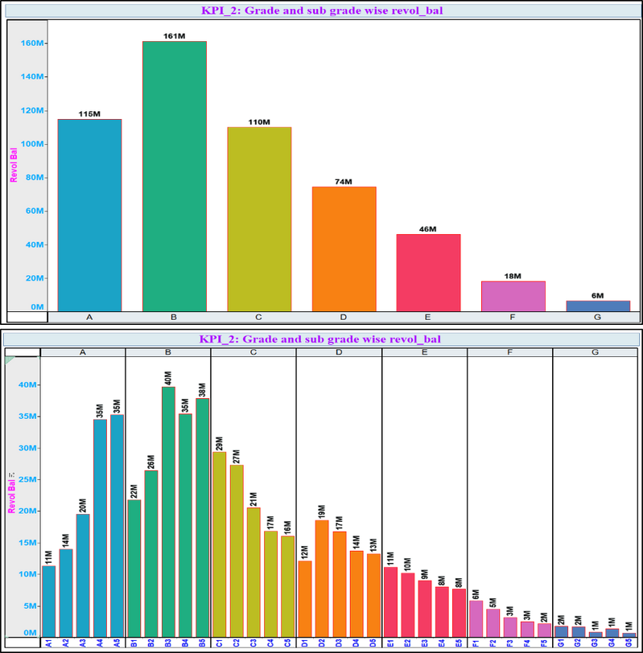
KPI 2 – Grade and sub grade wise revol balance
In KPI 1, we have to show the loan amount by year, in
which we can observe that it is continuously rising.
In 2007, the loan amount was 2 million and in 2011,
it went to 261 million.
The amount of the loan has increased by 259 million
in 4 years.
By leveraging this analysis, the bank can proactively
identify and mitigate potential risks, make sound
credit-related judgements, and maintain a vigilant oversight on the
health of its credit portfolio.

Slide 9
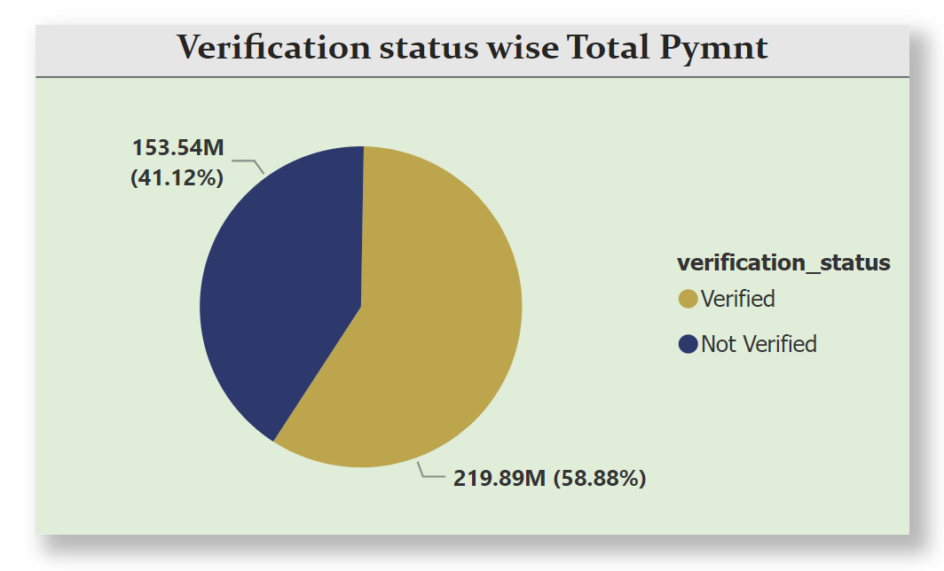

KPI 3 – Verification Status Wise Total Payment
We have highest (6.9k) verified accounts
opened and highest (7.8k) non-verified
accounts opened the year 2011
Mortgage has the highest total payment amount for
the verified accounts with 124.7 million and Rents has
the highest total payment amount for the non-verified
accounts with 72.15 million compared to the other
home ownerships.
Others has the lowest verified accounts (0.04k) and
non-verified accounts (0.05k) when compared to the
Others.
"A group problem-e t all group members"

Slide 10
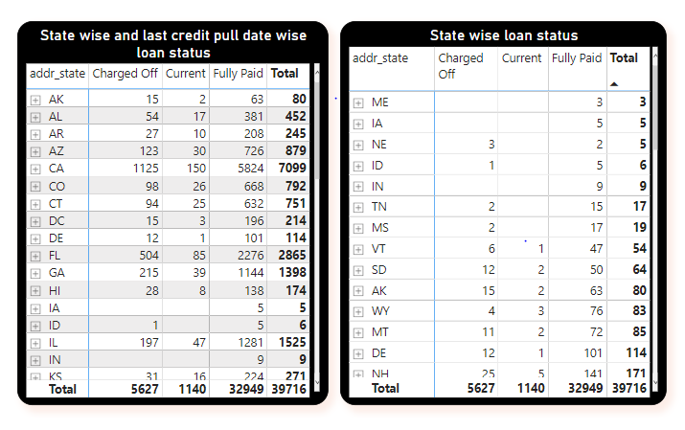
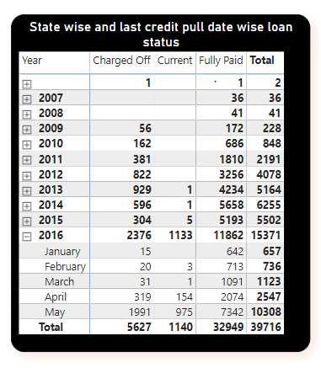
KPI 4. State and last credit pull date wise loan status
In KPI 4, we have to display loan status by state and last credited pull date .
The count of loan status for charged off is 5627, current is 1140, and fully paid is 32949 in which the total count is 39716.
For may 2016, the total count was 10308, which is the highest, and the least count was observed in 2007 in the month of May and July.
"Business analysts are a kind of switch from business problems to technological solutions."
The highest count of people who have taken the loan is 7099 which is in California and the least count is 3 which is in Maine.

Slide 11

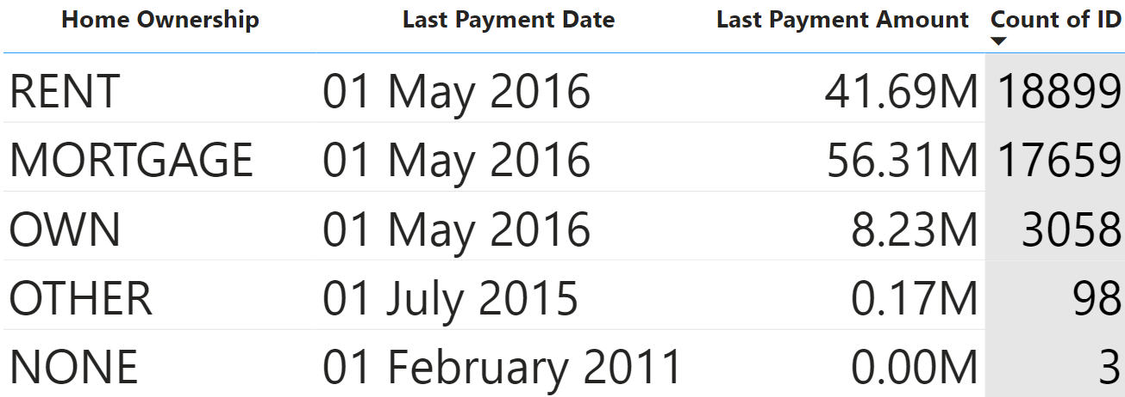


KPI 5 : Home Ownership And Last Payment Date
In KPI 5, we observed the last payment date for home ownership and total number of customers in each ownerships.
Here we could see that the total number of ID in Mortgage was less than Rent i.e. 17659, but the payment was 56.31M which is greater than Rent.
From this insight we can conclude that Mortgage pays more money in average when compare to Rent.

Slide 12



